Slide 1


JOB PORTAL :
PRESENTED BY :
Swapnil Dumbare

Slide 2
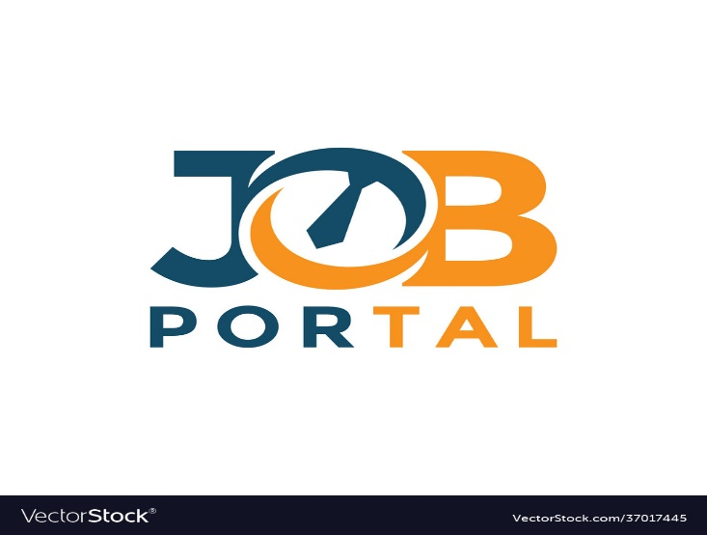
OVERVIEW :
Introduction
Aim of Project
Purpose & Solution
ER-Diagram
Software Used For Development
Overview of Software & Framework Used
Upgradation
Conclusion

Slide 3
INTRODUCTION :
Job portal is an application which connects employer and job seekers where employer are the source of the resources and the job seekers can find and apply for their targeted Job
This Website can be also providing information about online Job.
The customer can get the online registration
The job portal web application can be used by any employee to apply job and any employer are post to Job.

Slide 4
Aim of project :
AIM OF PROJECT :
Providing a platform for employers to post job listings and reach a wider pool of job applicants. Improving the efficiency and speed of the job search and recruitment process. Offering tools and resources to assist job seekers with resume building, interview preparation, and career development.

Slide 5
PURPOSE & SOLUTION :
Purpose :
Job portal is an online platform where companies can post job vacancies and job seekers can search and apply for jobs that match their skills and qualifications. It serves as a bridge between employers and job seekers, making it easier for both parties to connect and find suitable opportunities
Solution :
There are several online job portals available in India. One of the most popular ones is Naukri.com 1. It has over 5 lakh job listings and is used by both job seekers and recruiters 1. You can search for jobs based on your preferred location, industry, and experience level.

Slide 6
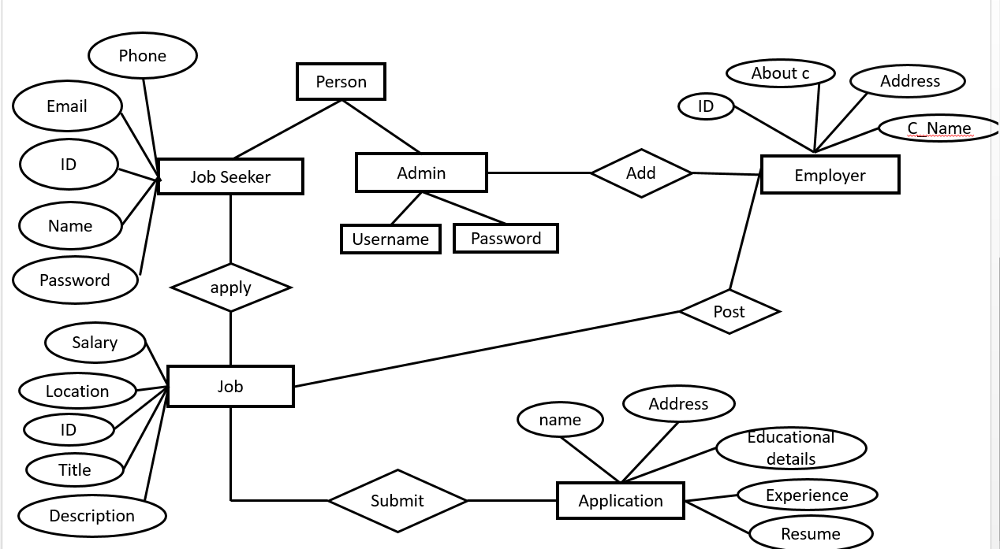
ER-DIAGRAM :

Slide 7
SOFTWARE FRAMEWORKS :
BACK-END SOFTWARE
FRONT-END SOFTWARE
Advanced Java:
Angular JS:
My-SQL
Spring boot
Postman

Slide 8
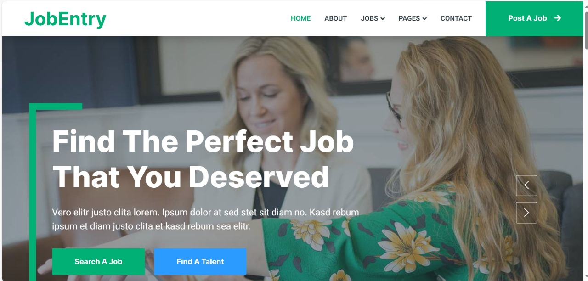

Front- page of website(ANGULAR- JS) :

Slide 9
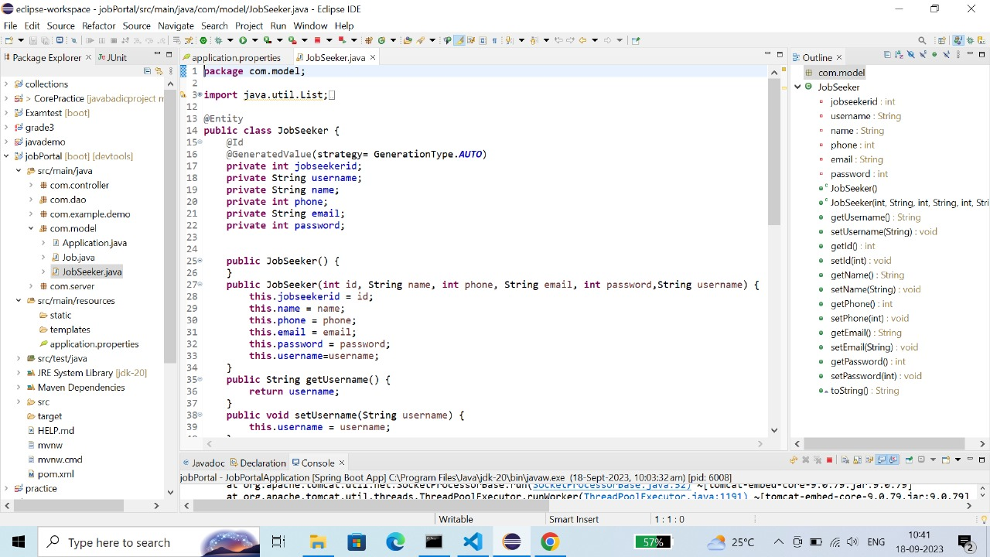
BACKEND DEVELOPMENT :

Slide 10
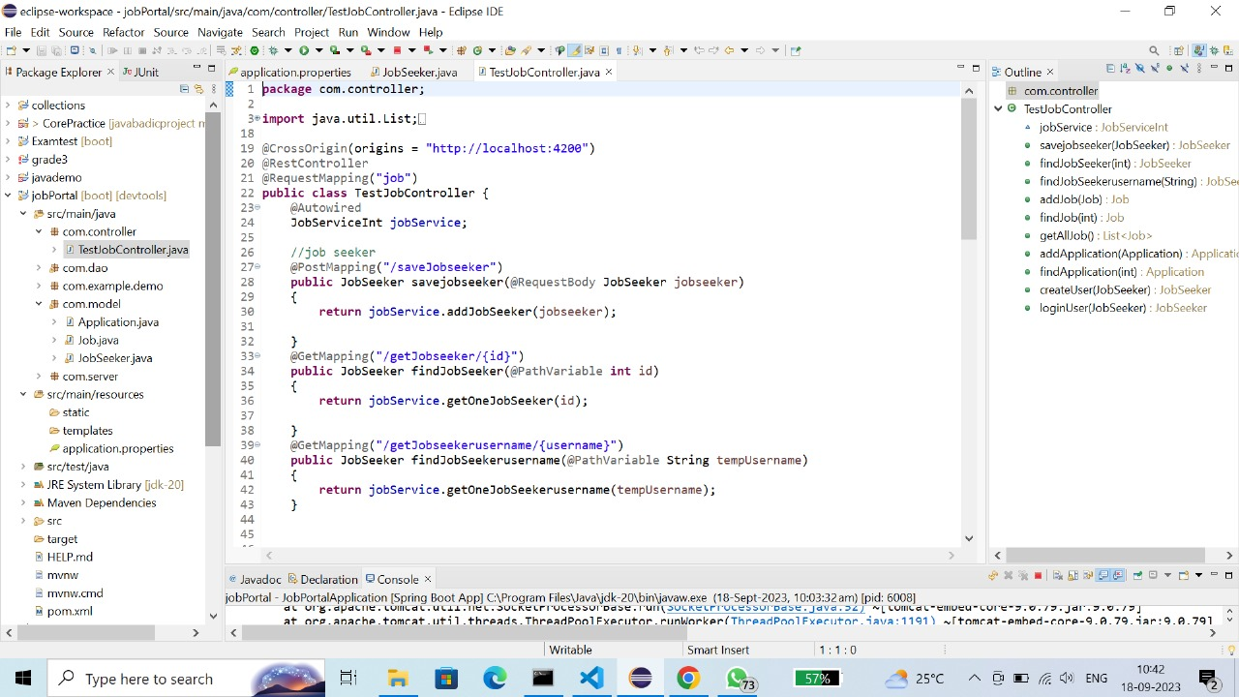

Slide 11
FUTURE UPGRADATION :
Improved search functionality: A job portal should have a robust search engine that allows users to find jobs based on their preferences. Future updates could include the ability to search for jobs by location, salary, and other criteria.
Mobile optimization: With more people using their smartphones to browse the internet, it’s essential to have a mobile-friendly job portal. Future updates could include optimizing the website for mobile devices.
Social media integration: Social media is an excellent way to reach potential candidates. Future updates could include integrating social media platforms like LinkedIn, Facebook, and Twitter into the job portal.
Automated resume screening: Screening resumes can be a time-consuming process. Future updates could include using artificial intelligence (AI) to screen resumes automatically.
Candidate tracking: Keeping track of candidates throughout the hiring process can be challenging. Future updates could include a candidate tracking system that allows recruiters to keep track of where each candidate is in the hiring process.

Slide 12
CONCLUSION :
The wider areas of job searching facilitate the quick and easy access to opportunities. The increasing job opportunities and changing scenario of the business environment today has made more people to search for better career and employers to search for better potential. This situation has prompted many to move to job portals to look for the ways that has been widely accepted and fully useful in job searching. In this sense the job portals assumes greater importance and we could develop such an efficient system which is used by lot many job hunters and employers.
…THANK YOU

